Slide 1
第三章习题

Slide 2
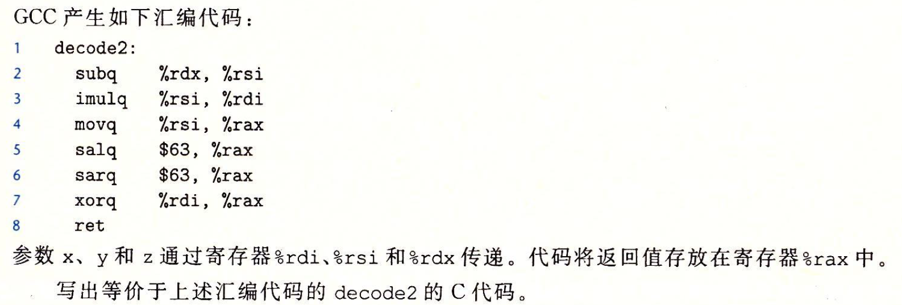
习题3.58
Long decode2(long x, long y, long z);
y=y-z;
x=x*y;
y=y<<63;
y=y>>63;
Return y^x;

Slide 3
习题3.58
Long decode2(long x, long y, long z);
long decode 2(long x, long y, long z){
int result=x*(y-z);
if ((y-z)&0x1)
result=~result;
return result;
}
y=y-z;
x=x*y;
y=y<<63;
y=y>>63;
Return y^x;

Slide 4
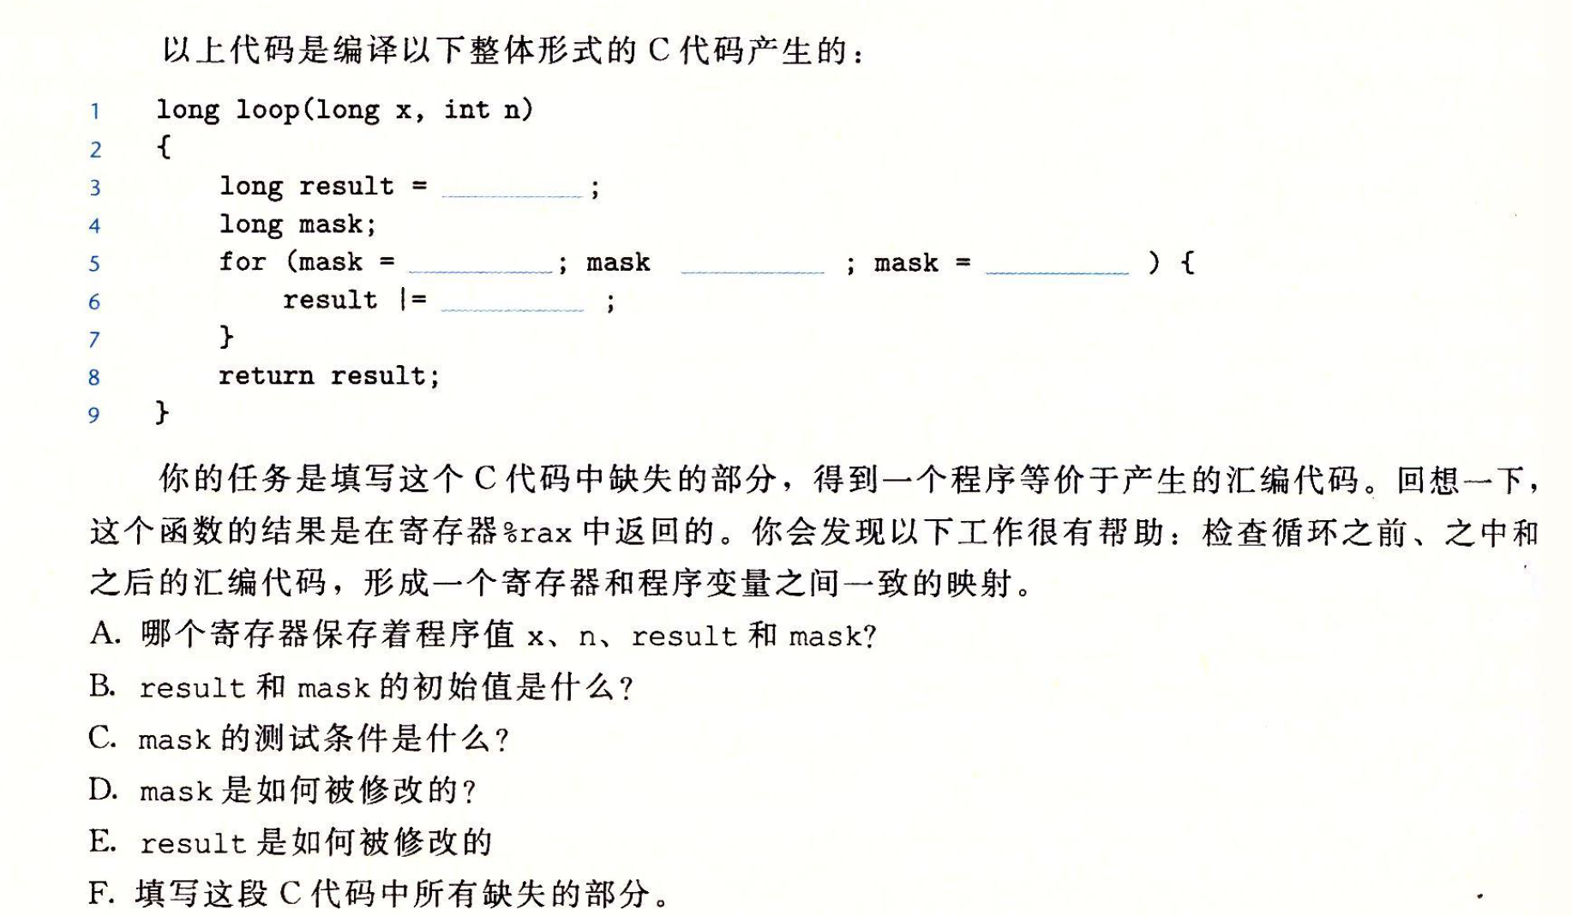
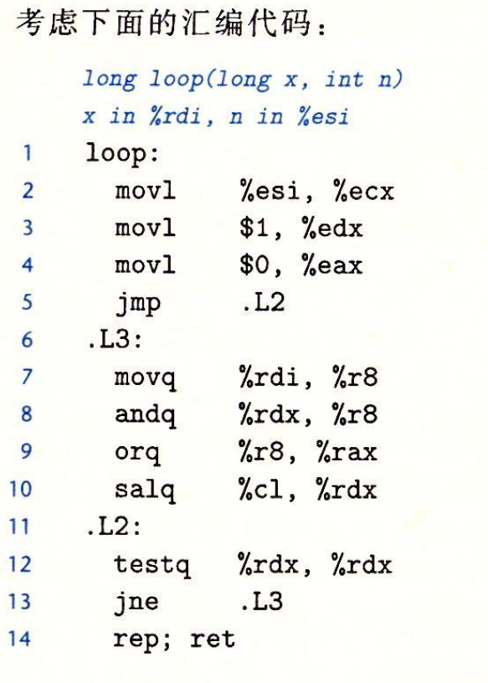
习题3.60

Slide 5
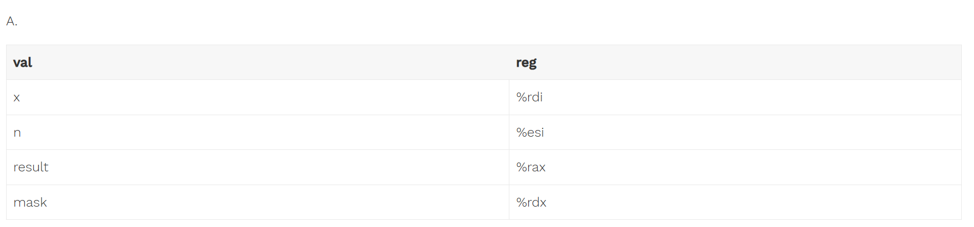
习题3.60
B. result = 0; mask = 1;
C. mask != 0
D.mask = mask << n
E.result = result | （x&mask）

Slide 6
习题3.60
0
1
!=0
mask<<n
X&mask

Slide 7
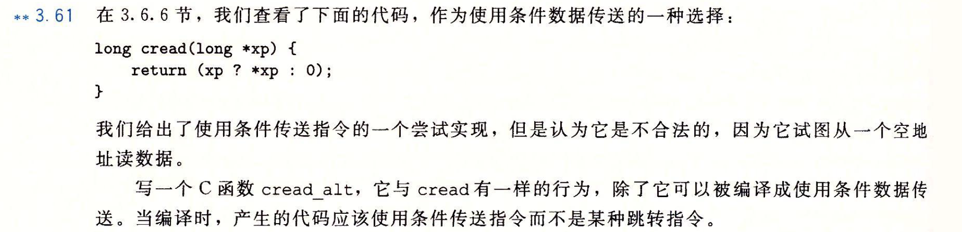
习题3.61
long cread_alt(long *xp) {
return (!xp ? 0 : *xp);
}

Slide 8
/*
* cread-alt.c
*/
#include <stdio.h>
#include <assert.h>
long cread(long *xp) {
return (xp ? *xp : 0);
}
long cread_alt(long *xp) {
return (!xp ? 0 : *xp);
}
int main(int argc, char* argv[]) {
long a = 0;
assert(cread(&a) == cread_alt(&a));
assert(cread(NULL) == cread_alt(NULL));
return 0;
}
# long cread(long *xp)
# xp in %rdi
cread:
movq (%rdi), %rax
testq %rdi, %rdi
movl $0, %edx
cmove %rdx, %rax
ret
# long cread_alt(long* xp)
# xp in %rdi
cread_alt:
movl $0, %eax
testq %rdi, %rdi
cmovne (%rdi), %rax

Slide 9
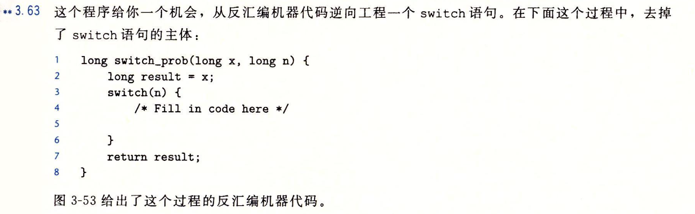
习题3.63

Slide 10
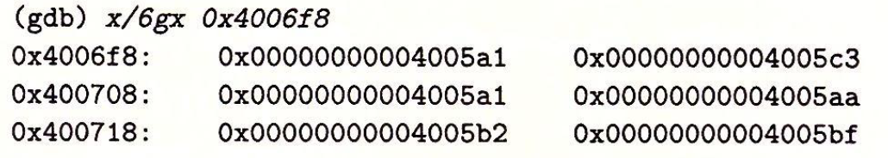
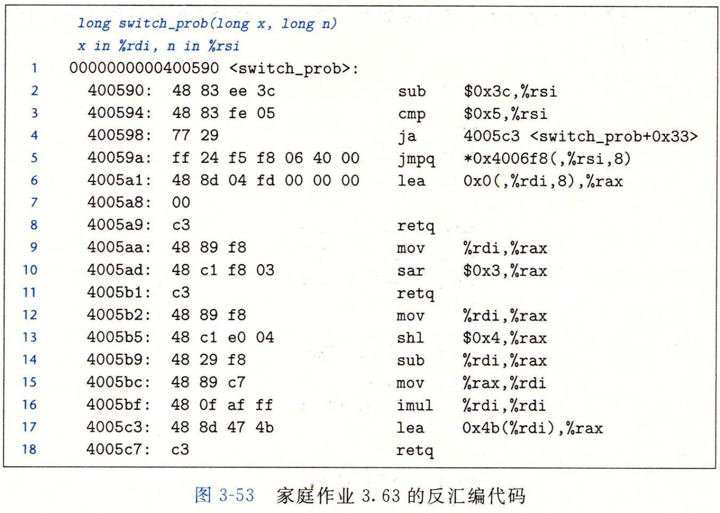

Slide 11
long switch_prob(long x, long n) {
long result = x;
switch(n) {
/* Fill in code here */
case 60:
case 62:
result = x * 8;
break;
case 63:
result = x >> 3;
break;
case 64:
x = x << 4 - x;
case 65:
x = x * x;
default:
result = x + 0x4B;
}
return result;
}

Slide 12
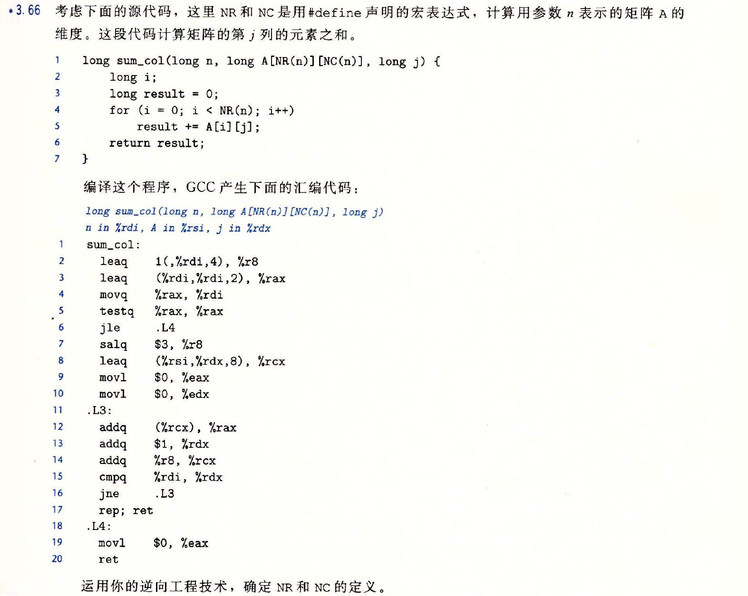
习题3.66

Slide 13
# long sum_col(long n, long A[NR(n)][NC(n)], long j)
# n in %rdi, A in %rsi, j in %rdx
sum_col:
leaq 1(,%rdi,4), %r8 # %r8= n*4 + 1
leaq (%rdi,%rdi,2), %rax # %rax = n*3
movq %rax, %rdi # %rdi = n*3
testq %rax, %rax
jle .L4 # n*3 <= 0, jump .L4
salq $3, %r8 # %r8 = %r8*2^3 = 8*(n*4 + 1)
leaq (%rsi,%rdx,8), %rcx # %rcx = j*8 + A
movl $0, %eax # %rax = 0
movl $0, %edx # %rdx = 0
.L3:
addq (%rcx), %rax # %rax = *(%rcx) = *(A + j*8)
addq $1, %rdx #%rdx= %rdx+1
addq %r8, %rcx # %rcx= %r8+%rcx= A + j*8 + 8*(n*4 + 1)
cmpq %rdi, %rdx
jne .L3 # if %rdx != n*3, loop
rep
ret
.L4:
movl $0, %eax # return 0
ret
NR=3*n
NC=n*4+1

Slide 14
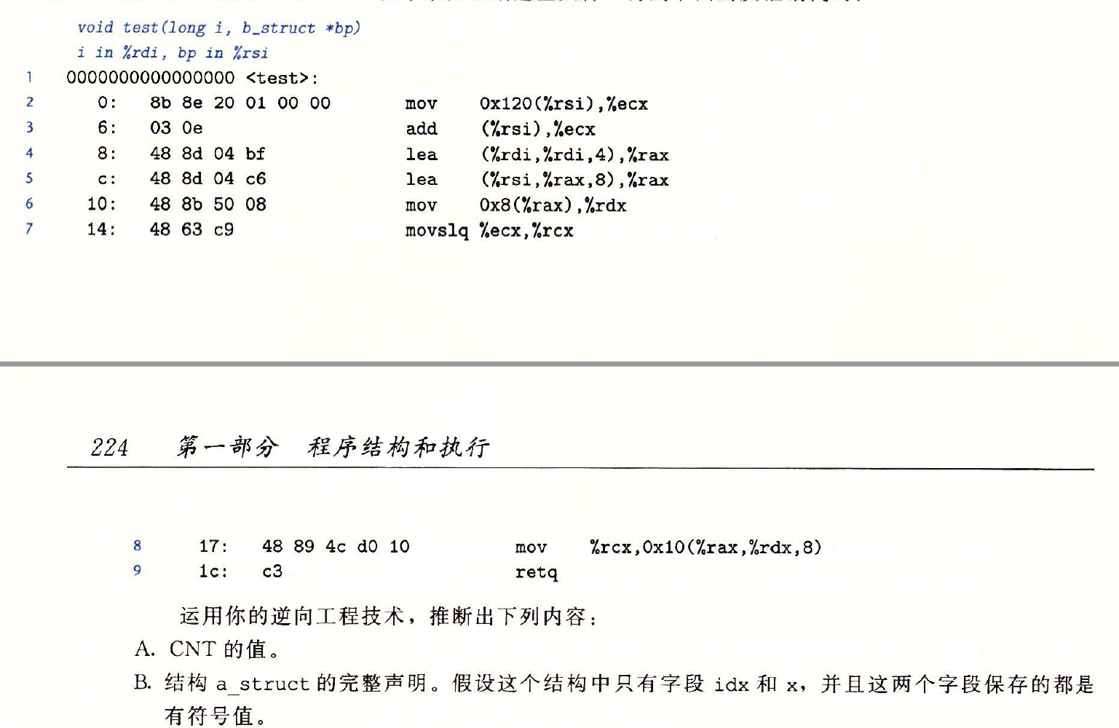
习题3.69
Typedef struct{
int first;
a_struct a[CNT];
int last;
} b_struct;
Void test(long i, b_struct *bp)
{
int n=bp->first+bp->last;
a_struct *ap=&bp->a[i];
ap->x[ap->idx]=n;
}

Slide 15
# void test(long i, b_struct *bp)
# i in %rdi, bp in %rsi
test:
mov 0x120(%rsi), %ecx # bp+0x120 fetch bp->last
add (%rsi), %ecx # bp->first + bp->last
lea (%rdi,%rdi,4), %rax # i*5
lea (%rsi,%rax,8), %rax # bp+i*40
# ap = &bp->a[i] = bp+i*40+8, +8 means skip int first
# so a_struct is aligned by 8, size is 40
# check last instrction, %rdx here saves value ap->idx!!!
# so in a_struct, idx is first element
mov 0x8(%rax), %rdx
movslq %ecx, %rcx # n = bp->first + bp->last, convert to long
# save n to address 8*(ap->idx) + bp+i*40+0x8 + 0x8 (0x10)
# bp+i*40+0x8 means ap
# ap + 0x8 means &(ap->x)
# ap + 0x8 + 8*(ap->idx) means &(ap-x[ap->idx])
# second element of a_struct is x, x is an array of long
# 8*(ap->idx) means idx is also long type
mov %rcx, 0x10(%rax,%rdx,8)
# size of a_struct is 40 and aligned by 8
# so array x has 4 long elements
# finally, a_struct is
# typedef struct {
# long idx,
# long x[4]
# } a_struct
retq

